Slide 1
Digital Portfolio
STUDENT NAME: K. DEEVITHA
REGISTER NO AND NMID: astvu36336324u18006
DEPARTMENT: B.SC.COMPUTER SCIENCE
COLLEGE: COLLEGE/ UNIVERSITY:SREE ABIRAAMI ARTS AND SCIENCE COLLEGE FOR WOMEN /THIRUVALLUVAR

Slide 2
PROJECT TITLE
DIGITAL FRONT END DEVELOPMENT

Slide 3


AGENDA
Problem Statement
Project Overview
End Users
Tools and Technologies
Portfolio design and Layout
Features and Functionality
Results and Screenshots
Conclusion
Github Link
3/21/2024 Annual Review

Slide 4

PROBLEM STATEMENT
Students and professionals struggle to showcase their skills and achievements effectively using traditional resumes.
Lack of a centralized, accessible, and visually appealing platform limits personal branding.
Employers and recruiters face challenges evaluating creativity and real-world project work.
Static documents do not reflect continuous growth, learning, or multimedia capabilities.

Slide 5

PROJECT OVERVIEW
The project aims to develop an interactive digital portfolio platform for users to showcase their skills, projects, and achievements.
It allows integration of multimedia elements like images, videos, and documents to enhance presentation.
Users can create customizable profiles with sections for education, experience, and certifications.

Slide 6

WHO ARE THE END USERS?
Students – to showcase academic achievements, projects, and skills for internships or job applications.
Job Seekers – to present professional experience, certifications, and personal branding online.
Freelancers & Creatives – to display portfolios of design, writing, photography, or other creative work.

Slide 7

TOOLS AND TECHNIQUES
Web Development Tools – HTML, CSS, JavaScript, and frameworks like React or Bootstrap for building responsive layouts.
Design Software – Tools like Adobe XD, Figma, or Canva for creating visually appealing interfaces and graphics.
Content Management Systems (CMS) – Platforms like WordPress or easy portfolio creation without coding.

Slide 8
POTFOLIO DESIGN AND LAYOUT
Clean & Consistent Layout – Use a uniform grid system, consistent fonts, and color schemes for a professional appearance.
Clear Navigation – Ensure easy access to sections like About, Work, Skills, and Contact.
Responsive Design – Optimize for mobile, tablet, and desktop viewing.
8

Slide 9
FEATURES AND FUNCTIONALITY
Interactive Gallery – Allows users to view projects with images, videos, or live demos.
Downloadable Resume/CV – Easy access to download professional documents.
Contact Form or Links – Enables direct communication via email or social media.

Slide 10
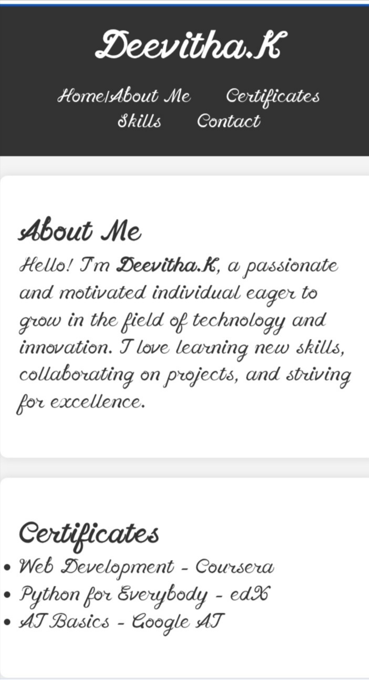
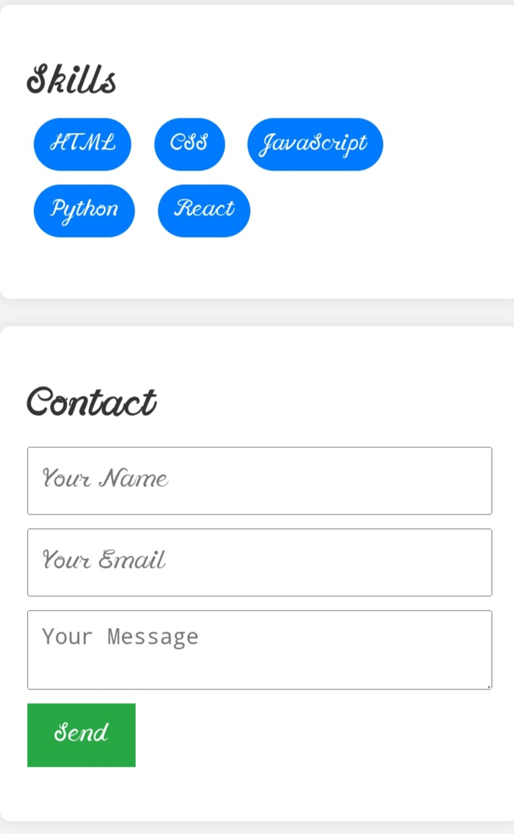

RESULTS AND SCREENSHOTS
3/21/2024 Annual Review
10

Slide 11
CONCLUSION
In conclusion, my digital portfolio highlights my journey of learning, creativity, and skill development. It presents a collection of my best work, carefully organized to reflect both quality and growth. Through various projects, I have demonstrated technical ability, problem-solving, and personal expression. The portfolio not only showcases my achievements but also my potential for future opportunities.
11

Slide 12
GITHUB LINK:
https://deevithakanniyappan.github.io/deeviportfolio/

